Slide 1


Research Plan: Simplified Restaurant Analysis

Slide 2
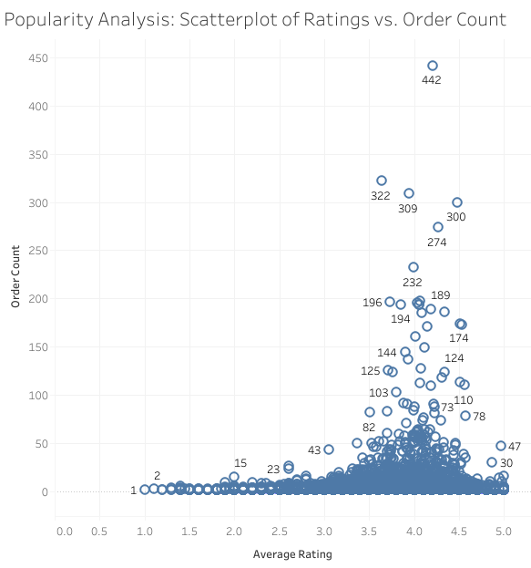

Popularity analysis:
Key Findings:
Concentration: Most restaurants cluster between an average rating of 3.5-5 and low order counts (<100). Outliers: High showing customer satisfaction drives popularity.
Order counts (>300) correlate with high ratings (4.5-5), indicating popular, well-rated restaurants. Trend: Higher ratings strongly align with higher order counts,

Slide 3
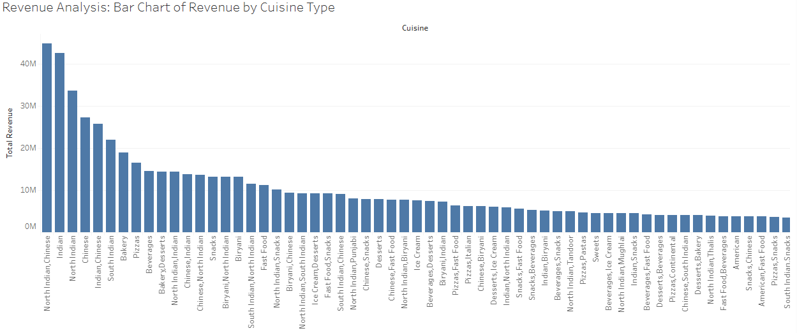
Revenue Analysis
Key Findings:
Top Revenue-Generating Cuisines: North Indian and Chinese cuisines dominate, with over 40M in revenue each, showcasing strong popularity.
Mid-Tier Revenue Cuisines: South Indian, Bakery, and Beverages are significant contributors but generate less revenue than the top cuisines.
Low Revenue Cuisines: Desserts and snacks generate lower revenues, reflecting niche appeal or limited demand.

Slide 4
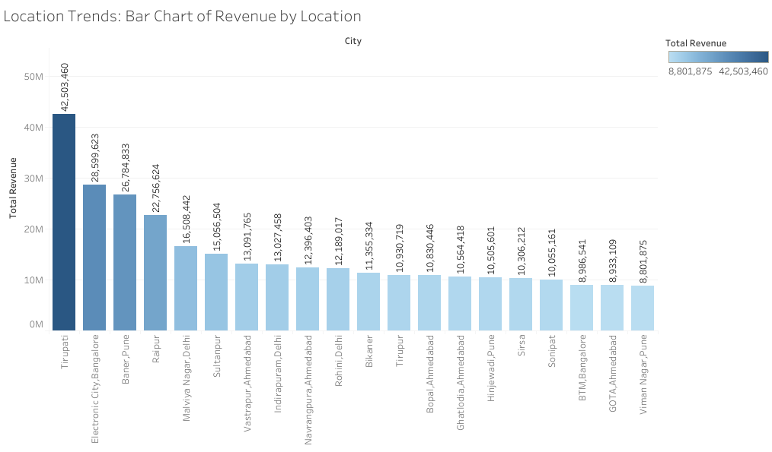
Location Trends
Key Findings:
Top Locations: Tirupati, Electronic City, and Bangalore lead in total revenue, with Tirupati generating over 42M.
Mid-Tier Locations: Cities like Banjara Hills and Malviya Nagar contribute moderate revenue, between 15M-27M.
Low-Performing Locations: Locations like Viman Nagar Pune and GOT A Ahmedabad generate under 10M, indicating weaker demand.

Slide 5
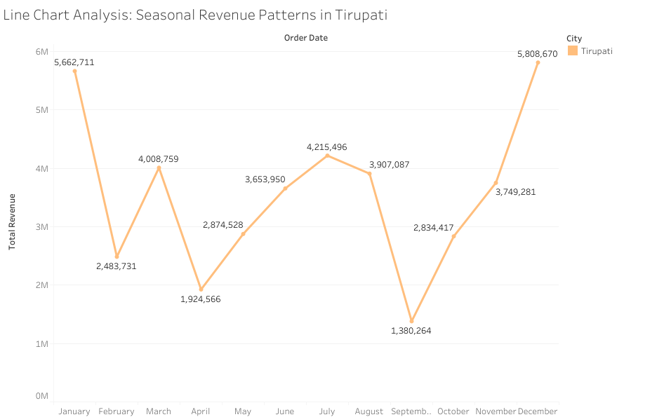
Seasonal Trends
Key Findings:
Seasonal Peaks: Revenue in Tirupati shows clear peaks in January and December, reaching over 5.6M and 5.8M, respectively.
Seasonal Lows: September's revenue was just 1.38M, indicating a significant dip. Fluctuating Trends: Revenue varies throughout the year, with moderate performance in other months like March and June.

Slide 6
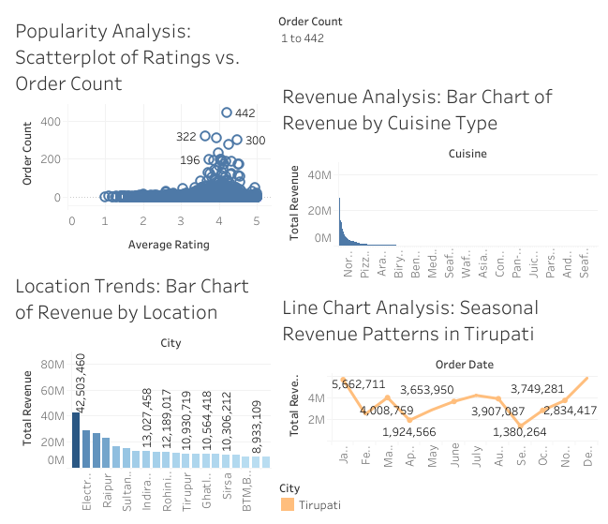
Dashboard

Slide 7

Final conclusions and recommendations
Popularity Analysis (Scatterplot):
Conclusion:
Customer ratings strongly impact restaurant popularity, as higher-rated establishments tend to have more orders.
Restaurants with ordinary ratings (below 3.5) generally struggle with order volume, emphasizing the importance of maintaining quality and satisfaction.
Recommendations:
Focus on improving service quality for restaurants with ratings below four stars to increase order potential.
Study the operational practices of top-performing outlier restaurants.
Consider implementing a review improvements program for restaurants with low ratings but decent order volumes.
Revenue Analysis (Bar Chart):
Conclusions:
Demand Dominance: North Indian and Chinese cuisines are the primary revenue drivers, likely due to their broad customer appeal.
Opportunity for Growth: Mid-tier cuisines like South Indian and Bakery show potential for scaling with targeted efforts.
Specialized Offerings: Low-performing cuisines may serve as complementary options or require innovation to boost appeal.
Recommendations:
Expand marketing for top-performing cuisine types into new markets.
Consider consolidating or rebranding lower-performing cuisine categories.
Develop promotional strategies for mid-tier cuisine types to increase their revenue share.

Slide 8
Final Conclusions and recommendations
Key Findings from Visualizations:
Location Trends (Bar Chart):
Conclusion
Major revenue comes from a few top-performing cities, highlighting high concentration in specific regions.
Mid-tier locations have the potential for growth with targeted strategies.
Low-performing areas require further analysis to identify challenges or untapped opportunities.
Recommendations:
Investigate successful practices in Tirupati for potential replication.
Develop market penetration strategies for lower-performing cities.
Consider resource reallocation to high-potential markets.
Seasonal Trends / Revenue Analysis (Line chart):
Conclusion
There is a strong seasonal demand in Tirupati during January and December, likely due to festivals or tourism.
September represents a potential off-season or low-demand period.
Recommendations:
Develop special promotions to boost sales during low seasons.
Plan resource allocation based on seasonal patterns.
Creating marketing campaigns to capitalize on peak seasons.

Slide 9
Seasonal Strategy
High Allocate additional resources, such as staffing, inventory, and marketing campaigns, to handle increased demand in January and December Season Focus:
Allocate additional resources, such as staffing, inventory, and marketing campaigns, to handle increased demand in January and December.
Offer premium packages or festival-themed promotions to capitalize on the high influx of customers.
Low Season Recovery:
Introduce discounts, loyalty programs, or limited-time offers in low-performing months like September to attract customers.
Collaborate with local events or tourism boards to drive more traffic during off-peak seasons.
Balanced Promotion:
During moderate months, focus on sustaining steady revenue through targeted campaigns, ensuring consistent customer engagement.

Slide 10
Metric Based Insights
Popularity Score:
Use the Popularity Score (Order Count × Rating) to identify top-performing restaurants.
Prioritize marketing and investment in these restaurants to further enhance their performance.
Average Order Value (AOV):
Calculate AOV = Total Revenue / Order Count for each restaurant.
Focus on strategies to increase AOV, such as upselling combos, premium menu items, or add-ons.
Target Underperformers:
Identify restaurants or cuisines with low popularity scores or AOV.
Offer staff training, optimize menus, or improve customer experience to increase ratings and drive higher revenue.
Location Optimization:
Rank cities or regions based on aggregated popularity scores and AOV.
Allocate more marketing efforts and investment to high-scoring areas while revising strategies for underperforming locations.
Benchmarking:
Set thresholds for metrics like AOV and Popularity Score to benchmark restaurant performance.
Regularly review and compare trends to adjust operational or marketing strategies effectively.

